Slide 1
Ogden Air Logistics Complex
Hill Air Force Base MACC IV Program Overview
1
Notes:
75 CEG (Jim)

Slide 2
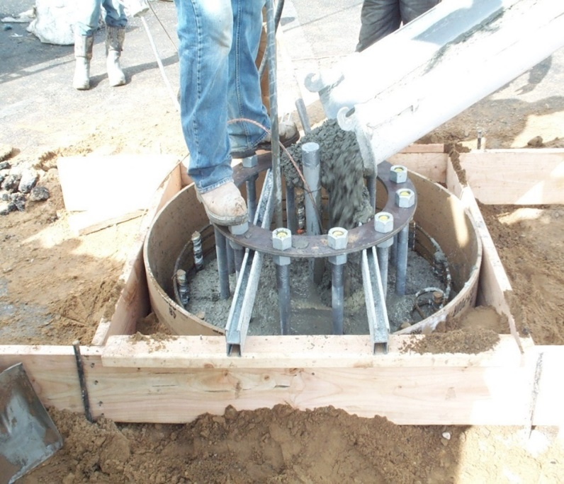
MACC IV Overview
UFC & Other Requirements
Submittals
Example Projects
Safety
Security
Q & A – Open Discussions
2
Notes:
PZ (TSgt Bedoya)
- The agenda for today’s industry day is as follows:

Slide 3
Task Order (TO) USAF Requirements
Air Force Design Guides (AFDG), Unified Facilities Criteria (UFC) and Engineering Technical Letters (ETL), found on: http://www.wbdg.org
Regulations
10 CFR 435 Energy Conservation Voluntary Performance Standards for New Buildings (Mandatory for Federal Buildings)
Energy Policy Act
Air Force Instruction (AFI)
AFI 32-10141, “Planning and Programming Fire Safety Deficiency Correction Projects”
3
Notes:
75 CEG (Jim)

Slide 4
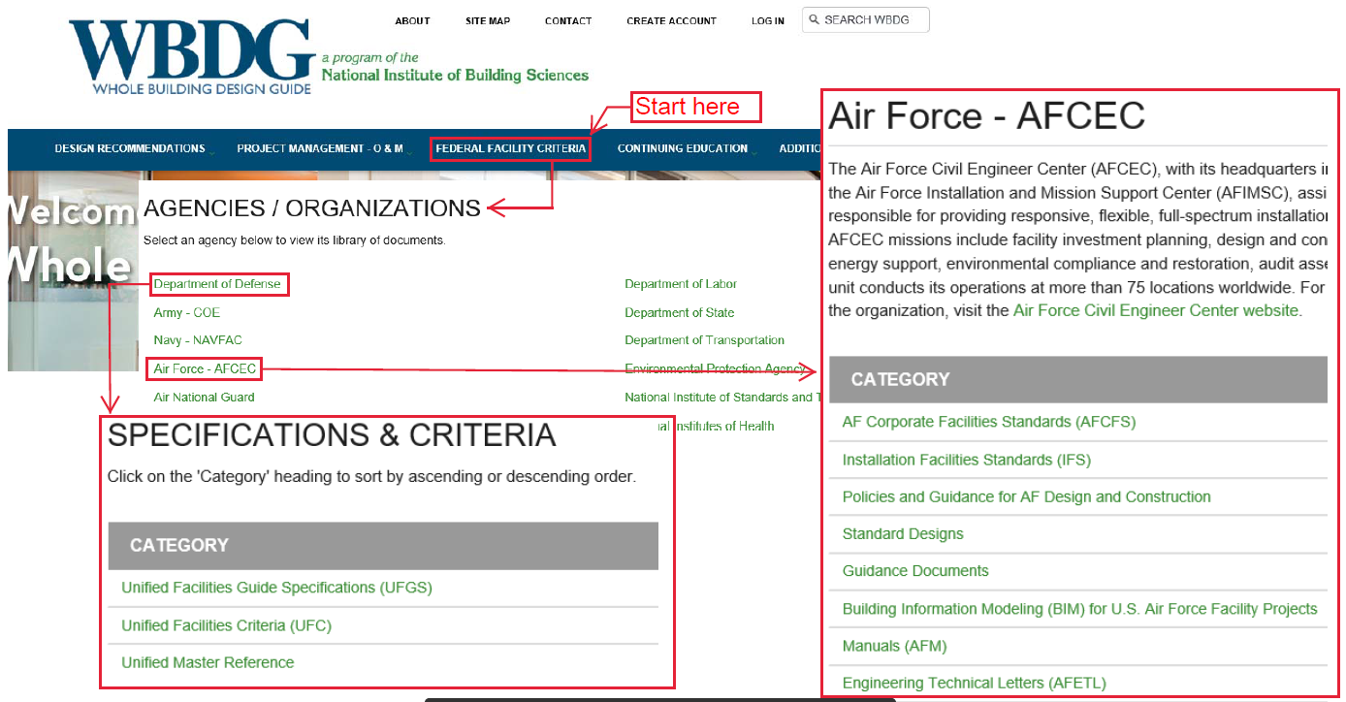
Task Order (TO) USAF Requirements
Navigating to Design Criteria from www.wbdg.org
4
Notes:
75 CEG (Jim)

Slide 5
TO Code Requirements
References:
International Building Code
International Mechanical Code
International Plumbing Code
International Energy Conservation Code
International Fuel Gas Code
Fire Safety Code, NFPA 1
Life Safety Code, National Fire Protection Association, NFPA 101
National Electric Code, NFPA 70
National Electric Safety Code, ANSI C2
Others as applicable to TO scope
5
Notes:
75 CEG (Jim)
Here are some examples of the code requirements that must be met on the MACC IV

Slide 6
TO Standard Requirements
References:
Base Facility Design Standard
Base Architectural Compatibility Standard
SCXP Telecommunications Installation Criteria for Facility Design and Renovation
Air Installation Compatible Use Zone (AICUZ), Hill AFB, Amended April 1982
ASCE/SEI 7-05 Minimum Design Loads for Buildings and Other Structures
ASHRAE Standard 62.1-2013, Ventilation for Acceptable Indoor Air Quality
6
Notes:
75 CEG (Jim)
Specific requirements for Hill AFB and geographically separated locations supported

Slide 7
TO Standard Requirements (Con’t)
References (Con’t):
ASHRAE Standard 90.1-2013, Energy Standard for Buildings Except Low Rise Residential Buildings
Illuminating Engineering Society of North America, Reference and Application Lighting Handbook
ICSSC RP6 - Standards of Seismic Safety for Existing Federally Owned and Leased Buildings
Architectural Barriers Act (ABA) Accessibility Standard for Department of Defense Facilities
Other standards as applicable
7
Notes:
75 CEG (Jim)
Specific requirements for Hill AFB and geographically separated locations supported

Slide 8
TO Design Submittals
Basis of Design (Design Analysis)
Design Narrative
Engineering Calculations
Concept, 30%, 60%, 90%, 100% (Final)
Drawings (w/ HAFB Title block)
UFGS Specifications (Using SpecsIntact)
Material and Equipment Cut Sheets
Quality Control Plans
Maintenance Plans
Sub-Contracting Plans
Project Schedules
8
Notes:
8
75 CEG (Jim)

Slide 9
TO Construction Submittals
References:
Safety Plan Tailored to Task Order
Material Submittals
Progress Schedules and Reports
Red Line/As-Built Drawings & Specifications
AutoCAD, pdf, paper
Test Reports
Includes Test & Balance, Fire Suppression, Concrete Strength, etc.
Commissioning Report
Independent Commissioning Contractor
Maintenance Manuals
Custom and Off the Shelf
Transfer & Acceptance of DoD Real Property (DD Form1354)
Others
9
Notes:
75 CEG (Jim)

Slide 10
Example MACC Projects
Example 1 - 388th & 419th FW B5 Bay J Renovation ~$2.3M
Reconfiguration/Remodel of Existing Bldg
Example 2 - B225 Repair High Bay for F-35 Program ~$5M
Reconfiguration of Hangar for F-35 Maintenance Bays
Example 3 - B507 Blast Booth Addition ~$1M
Building Addition for New Blast Booth Equipment
Example 4 - B341 Fire Alarm Replacement ~$350K
Fire Alarm and Mass Notification System
Example 5 - Little Mountain Substation
Upgrade of Substation and Primary Distribution
Example 6 - 388th Hanger B43 Renovation ~$5M
Fire Suppression and Structural Upgrades
Example 7 - 388th B120 Egress Project ~$2.8M
Provide New Exterior Egress and Fire Protection
10
Notes:
75 CEG (Jim)

Slide 11
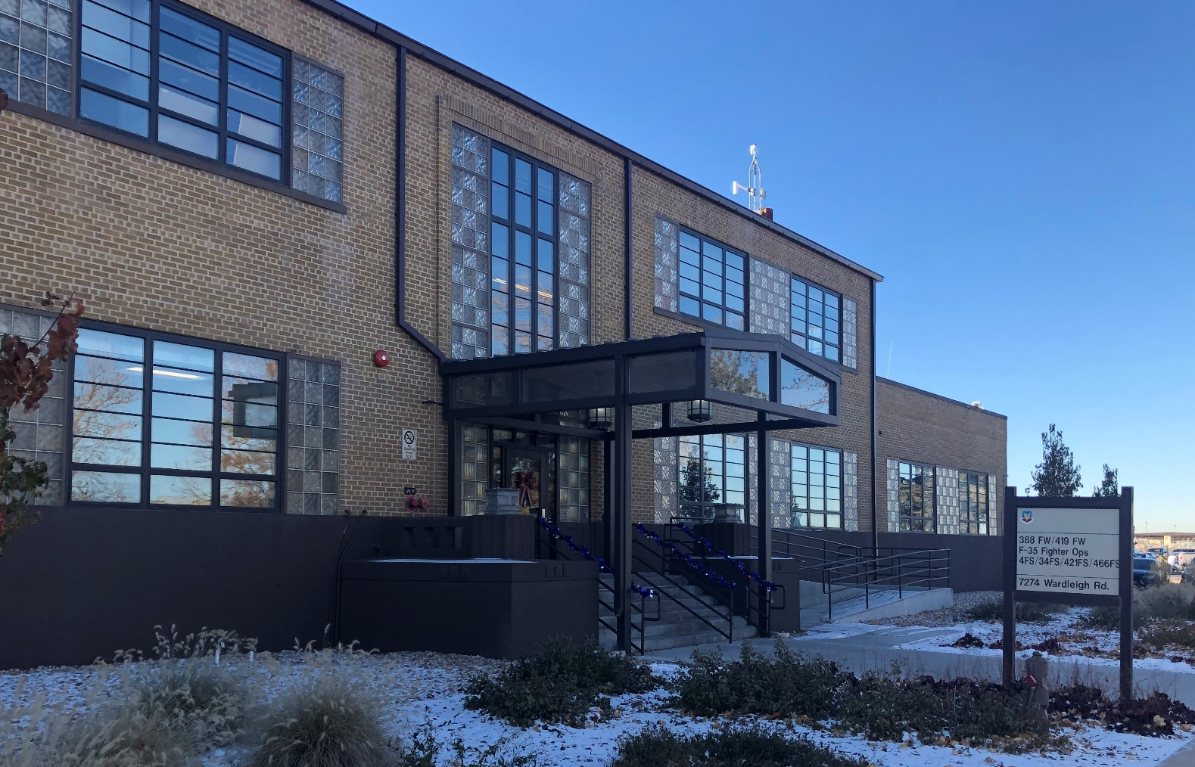
Ex 1 - 388th & 419th FW B5 Bay J Renovation
Design & Build of 19,250 SF for 388th & 419th FW Squadrons
11
Notes:
11
75 CEG (Jim)

Slide 12
Ex 1 - 388th & 419th FW B5 Bay J Renovation (Con’t)
Project Facts:
Demolition & reconstruction of structure, HVAC, lighting, roofing, electrical, comm, ACS, IDS
STC sound wall systems for briefing and mission planning spaces
ALIS server room for F-35 mission support
Modification of existing fire protection system
Finishes including anti-static coating, carpet, ceramic tile, epoxy flooring, etc.
Major primary electrical distribution upgrade to support renovated spaces & existing adjacent spaces
12
Notes:
12
75 CEG (Jim)

Slide 13
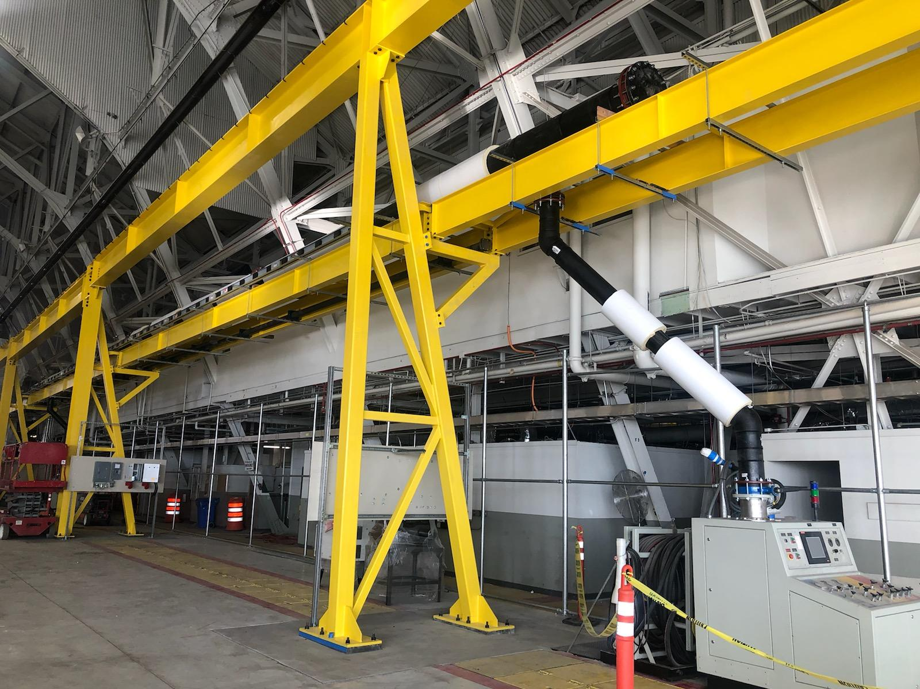
Ex 2 - B225 Repair High Bay for F-35 Program
Design & Build of 40,000 SF in Existing Hangar Facility
13
Notes:
13
75 CEG (Jim)

Slide 14
Ex 2 - B225 Repair High Bay for F-35 Program (Con’t)
Project Facts:
Design of secure space for F-35 maintenance bays
Demolition and reconfiguration of electrical distribution system
Remove 3 existing C-130 work stands and install overhead crane to service 10 F-35 docks
Installation of operator control consoles for aircraft systems testing
New grounding system compliant with Lockheed specifications
Plumb 10 docks for avionics air conditioning, hydraulic power, and DC power for aircraft
14
Notes:
14
75 CEG (Jim)

Slide 15
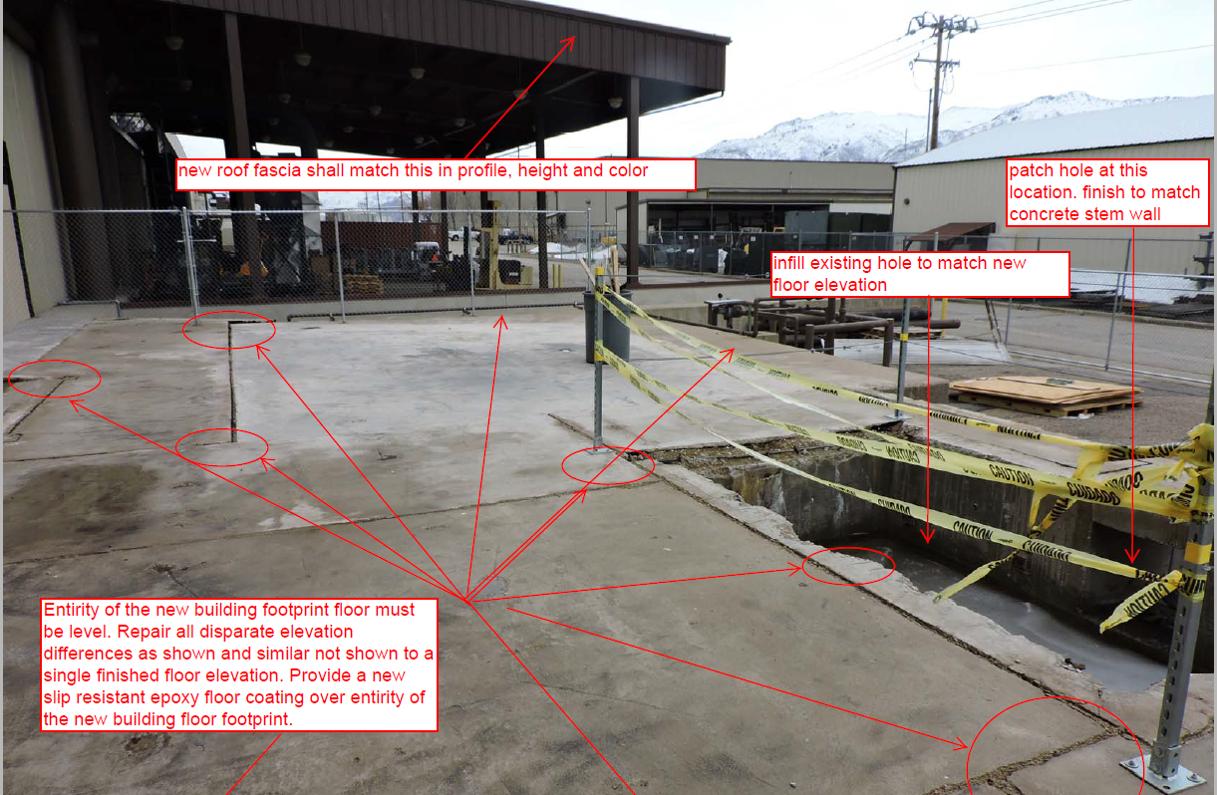
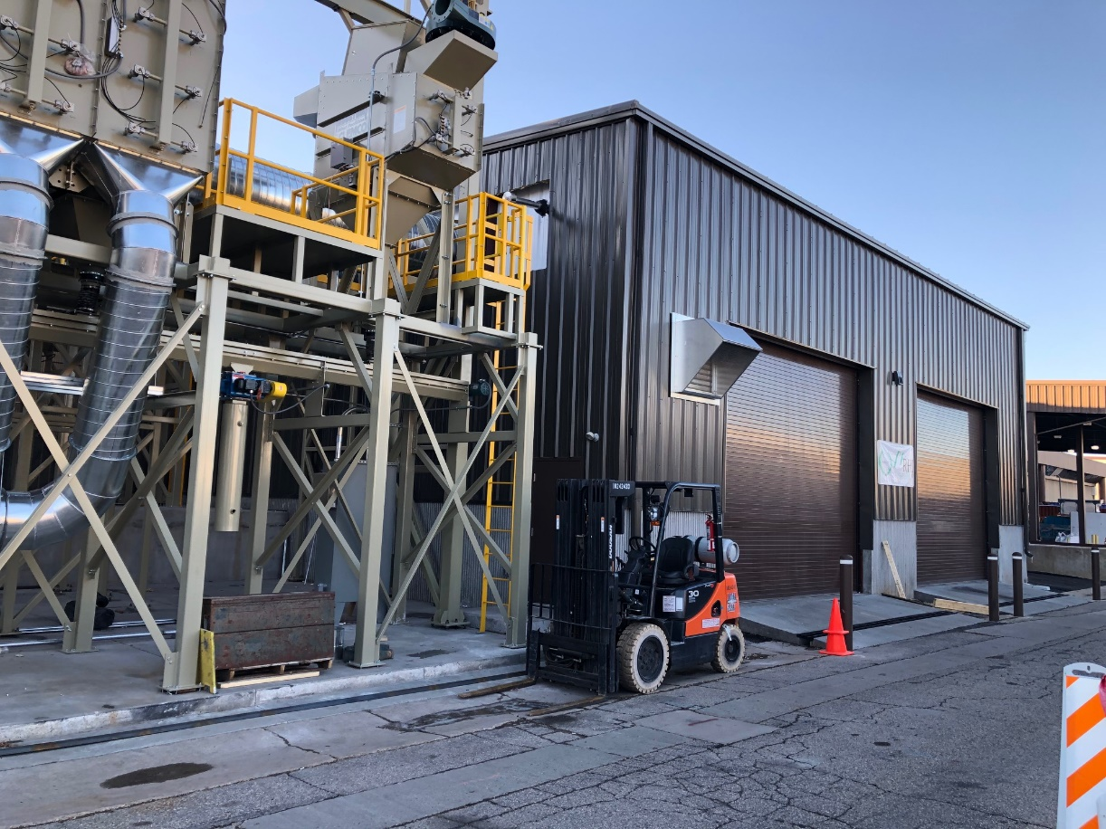
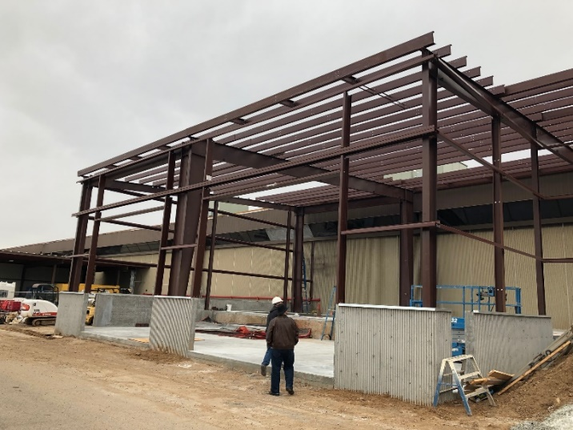
Ex 3 - B507 Blast Booth Addition
Design & Build 4200SF Addition onto an Existing Larger Process Building.
15
Notes:
75 CEG (Jim)

Slide 16
Ex 3 - B507 Blast Booth Addition (Con’t)
Project Facts:
Evaluation of existing structure with adaptations for new addition
Fire suppression and fire alarm system add-ons to existing larger systems
Coordination and integration with blast booth equipment provider under a separate contract
New ramps over existing waterways to roll up doors
Adaptation of schedule due to differing site conditions
16
Notes:
75 CEG (Jim)

Slide 17
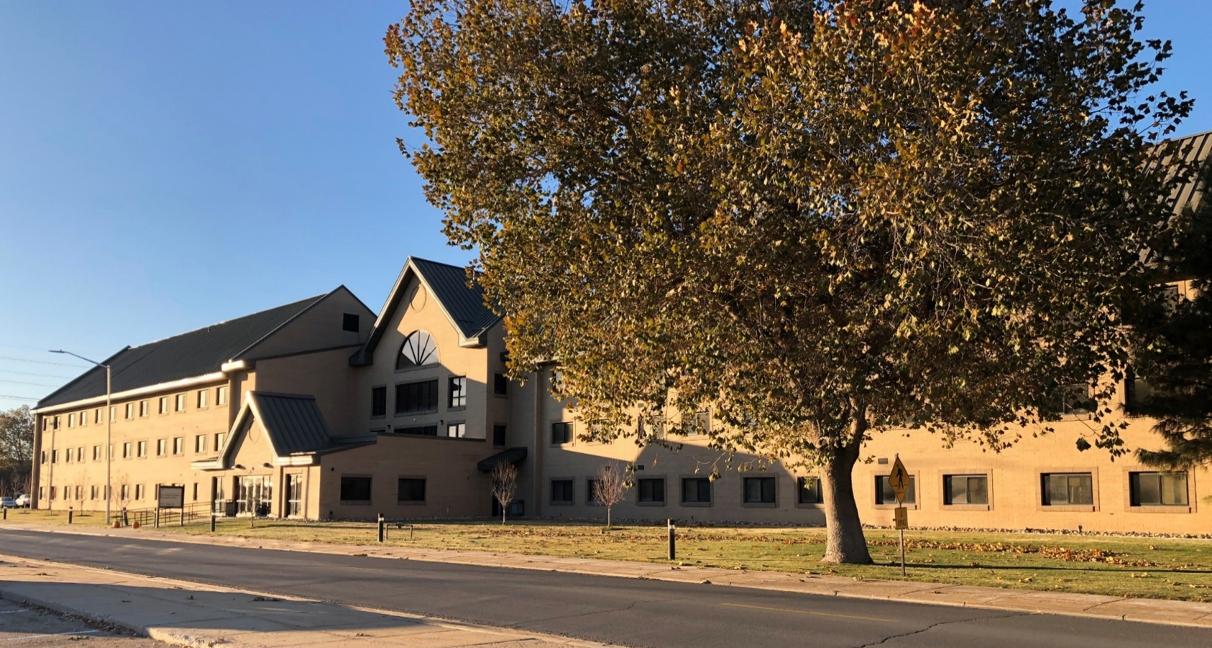
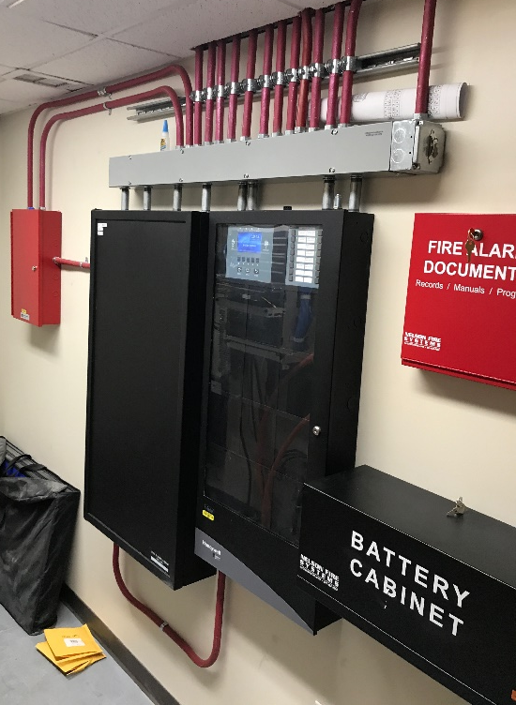
Ex 4 - B341 Fire Alarm Replacement
Design & Build New Fire Alarm and Mass Notification System for a 3-Story Dormitory Building with 144 Resident Rooms
17
Notes:
75 CEG (Jim)

Slide 18
Ex 4 - B341 Fire Alarm Replacement (Con’t)
Project Facts:
Maintained existing fire alarm system until the new system was fully operational and tested.
Addition of Mass Notification System to comply with current UFC/Air Force requirements
Complete demolition and removal of previous system
Coordination with Housing for supervised access to rooms for work
18
Notes:
75 CEG (Jim)

Slide 19
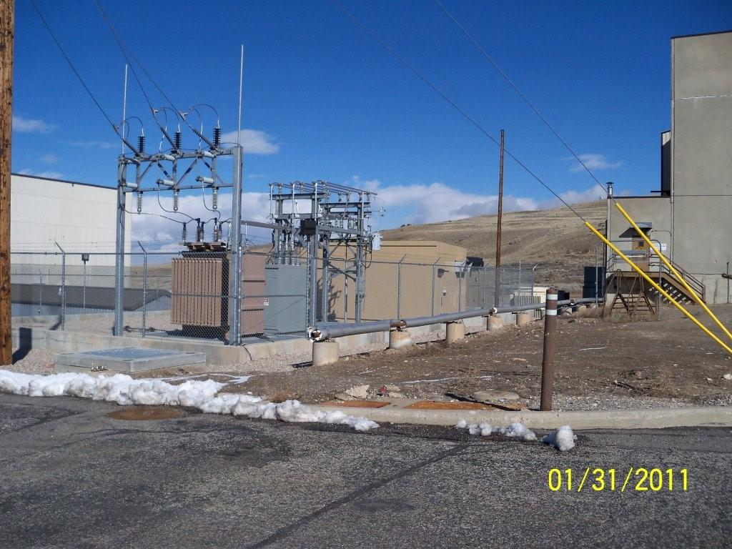
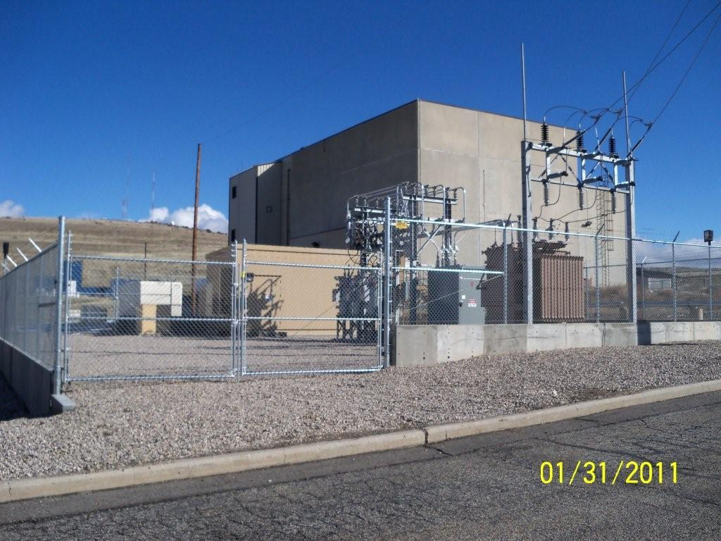
Ex 5 - Little Mountain Substation
Demolition and Upgrade of Substation and Primary Electrical Distribution System
19
Notes:
75 CEG (Jim)

Slide 20
Ex 5 - Little Mountain Substation (Con’t)
Project Facts:
Demolish old 4,160 volt electrical substation, feeders and distribution transformers
Construct new 12KV substation with 5 MVA transformer, metering, voltage regulation, switchgear, capacitor bank, and 1MW emergency generator
Construct new 12KV distribution system to include underground and overhead conductors, distribution transformers, distribution switches.
Construct new 480 volt and 120 volt secondary distribution
20
Notes:
75 CEG (Jim)

Slide 21
Ex 6 - Hangar B43 Renovation
Renovate ~ 22,000 SF fuel cell maintenance facility
Complete architectural renovation of office space including new handicapped accessible restrooms and men’s/women’s locker room
New structural steel upgrades to hold new hangar doors
Replace existing fire suppression with high expansion foam
Construct new lightning protection system
21
Notes:
75 CEG (Jim)

Slide 22
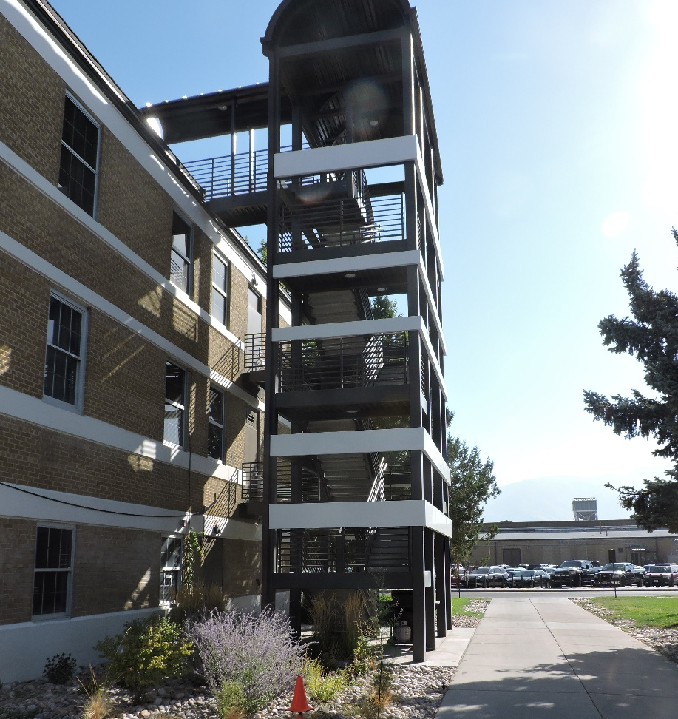
Ex 7 - B120 Egress Project
Design & Build to Remedy Egress Deficiencies in Existing Building
Notes:
22
75 CEG (Jim)

Slide 23
Ex 7 - B120 Egress Project (Con’t)
Project Facts:
Provided new exterior egress stairway
Added new automatic sprinkler system throughout the building
Added code required interior fire separation for interior stairs
Provided various exterior improvements
Upgrades to provide ADA compliant access
Notes:
23
75 CEG (Jim)

Slide 24
Safety
All Contractors Must Comply With
OSHA Requirement - 29 CFR Part 1926 Safety and Health Regulations for Construction
Hill AFB Specifications 01 35 26 Government Safety Requirements and Appendix C
US Army Corps of Engineers - EM 385-1-1
Safety and Health Requirements Manual
Safety Plan Tailored to Task Order
Always provide required Personal Protective Equipment (PPE)
Other Requirements
24
Notes:
75 CEG (Jim)

Slide 25
Security
Reference: IAW Hill Integrated Defense Plan
HAFB Security requirements, including disqualifiers, is subject to change without prior notice
Positive Access Control
Unescorted Access Requirements
Visitor Authorization List (VAL)
Common Access Card (CAC)
Defense Biometrics ID Sys (DBIDS)
Criminal background history
Access to Secure Areas
Escorts
Controlled Area Badges
Free zone
25

Slide 26
Security (Con’t)
Disqualifiers
Any felony involving any type of assault
Any felony involving any type of arson
Any felony involving any type of burglary or robbery
Any felony involving possession or distribution of stolen property
Any felony involving any type of willful destruction of property
Any felony involving violence at an airport
Any felony involving any type of threat or disruption to the public
Any type of extortion or bribery
Any type of theft, deception, fraud or falsehood
Importation or manufacture of a controlled substance
Distribution of or intent to distribute a controlled substance
Illegal possession or use of a controlled substance
Any conspiracy to commit any of the criminal acts listed above
26

Slide 27
Security (Con’t)
Disqualifiers (Con’t)
Espionage, sabotage, treason or terrorism
Criminal homicide in all forms to include murder, manslaughter and/or negligent homicide
Kidnapping, hostage taking, human trafficking / smuggling
Mayhem
Maiming
Rape, forcible sodomy, sexual abuse or sexual assault
Any sexual offense involving a minor or child including child molestation or child pornography
Child abuse
Any active want or warrant
Any conspiracy to commit any of the above acts
27

Slide 28
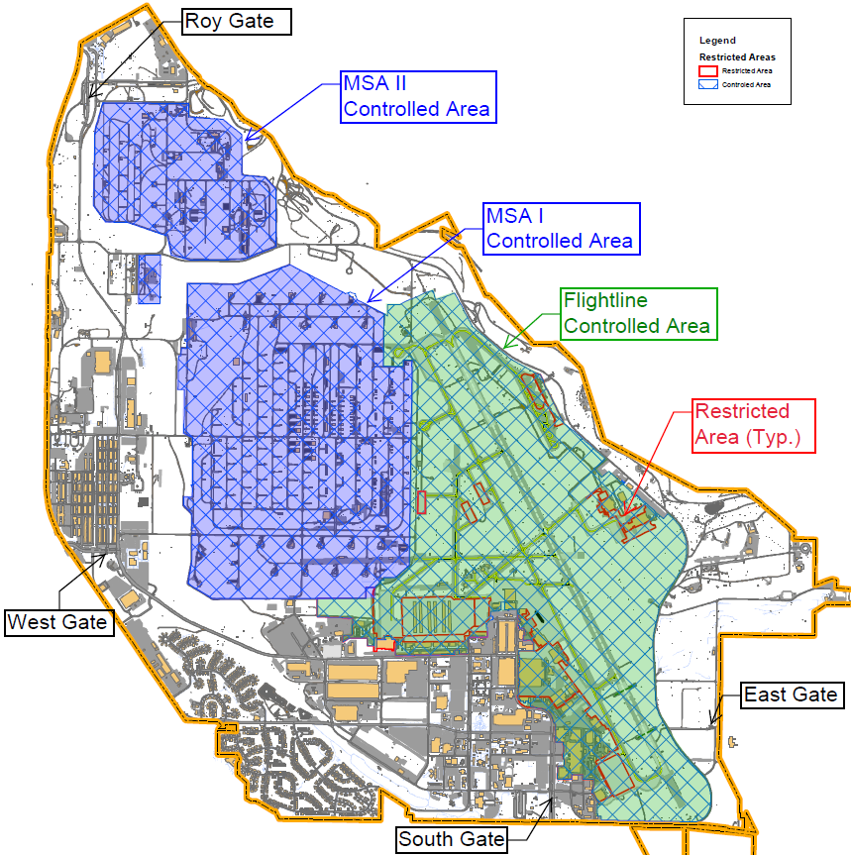
Security (Con’t)
28

Slide 29
Questions
29
Notes:
Back to TSgt Bedoya

