Slide 1
Virtual Pre-Proposal Conference ROCKY MOUNTAIN NATIONAL PARK REPLACE UNDERSIZED ENTRANCE STATION AT FALL RIVER ENTRANCE Solicitation: 140P2022R0005 NPS PMIS No: ROMO 160755 Also Includes: ROMO 199703: Rehabilitate Bighorn Ranger Station/Fall River Entrance Station Wastewater System ROMO 249028: Rehabilitate Bighorn Ranger Station/Fall River Entrance Water System ROMO 318223: Fall River Road Transportation Improvements THIS MEETING WILL BE RECORDED April 7, 2022

Slide 2
Agenda
WELCOME Emmeline Morris, DSC
INTRODUCTIONS Emmeline Morris, DSC Project Manager
PROJECT OVERVIEW Emmeline Morris, DSC Project Manager
BID INFORMATION Tim Burger, Contracting Officer
BID CLINS Tim Burger, Contracting Officer
VIRTUAL CONFERENCE + PHYSICAL TOUR Tim Burger, Contracting Officer
PRE-PROPOSAL CONFERENCE QUESTIONS Tim Burger, Contracting Officer
CONCLUSION Emmeline Morris, DSC Project Manager

Slide 3
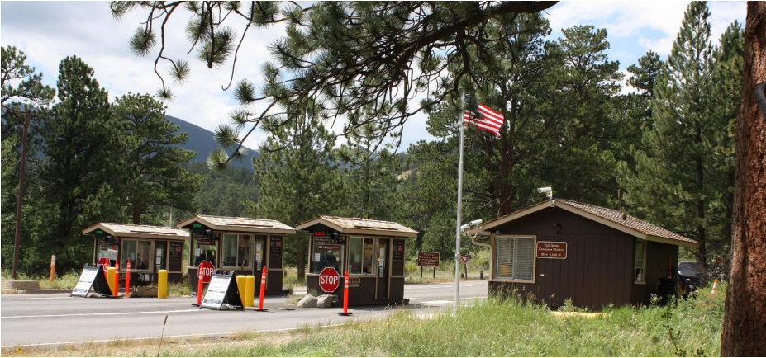
NPS/ROMO – Fall River Entrance

Slide 4
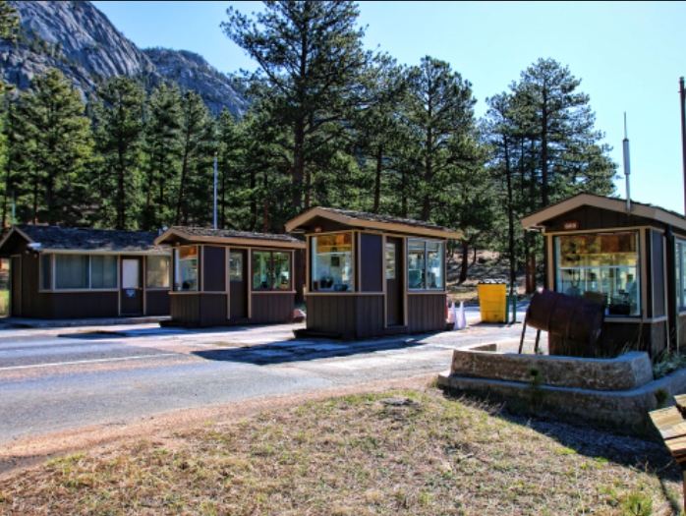
Overview
Location
Purpose
History
Significant Features
Existing Conditions
Project Scope of Work
Project Resources

Slide 5
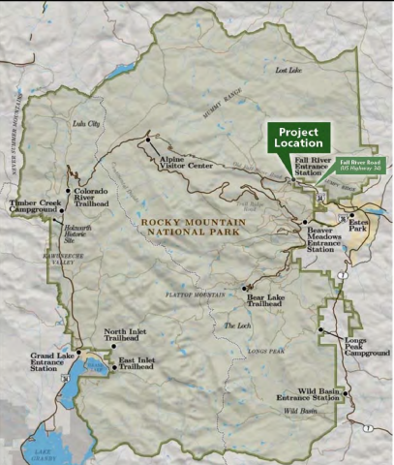
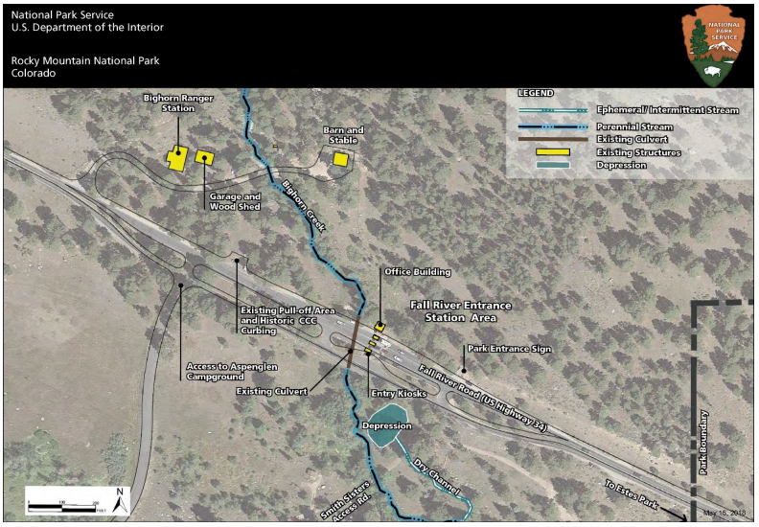
Location
Bighorn Ranger Station
Fall River Entrance Station Area
US HWY 34
Location Map
Aerial image of the site

Slide 6
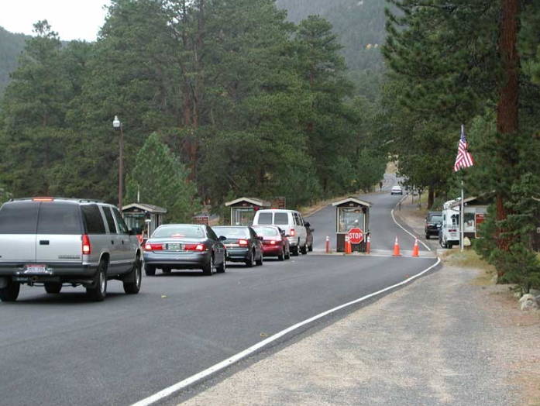
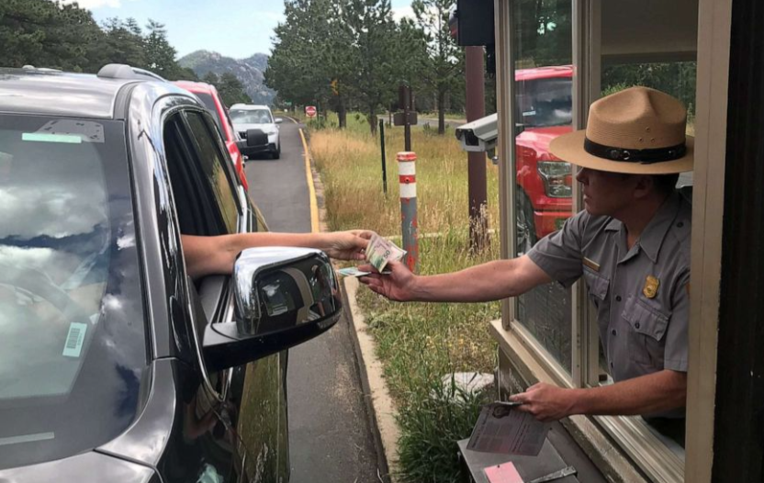
Purpose
Purpose and Need of this Project:
Improve employee working conditions, visitor safety, traffic flow and experience
Improve the efficiency, reliability and sustainability of park operations
Protect cultural and natural resources
Provide opportunities for the benefit, education, recreational use and enjoyment
Provide accessible facilities and parking for employees

Slide 7
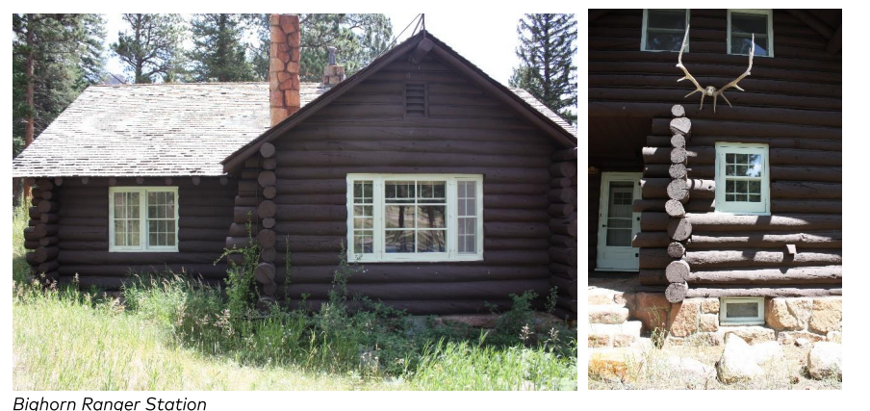
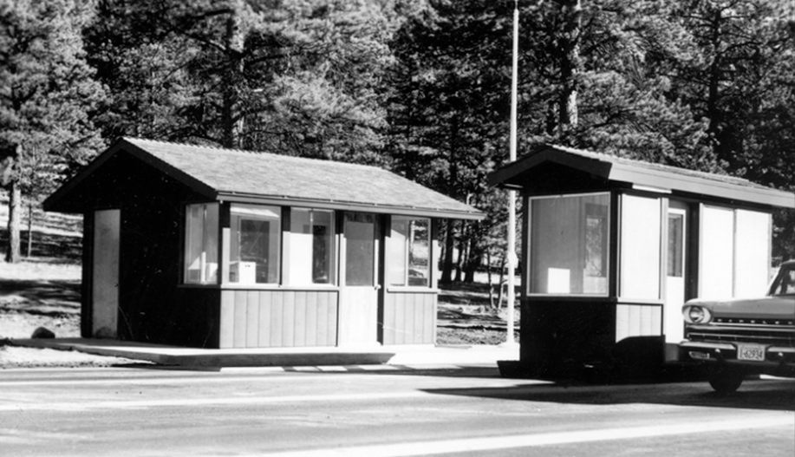
History
Big Horn Ranger Station – 1935
Fall River Office and Kiosks – 1960

Slide 8
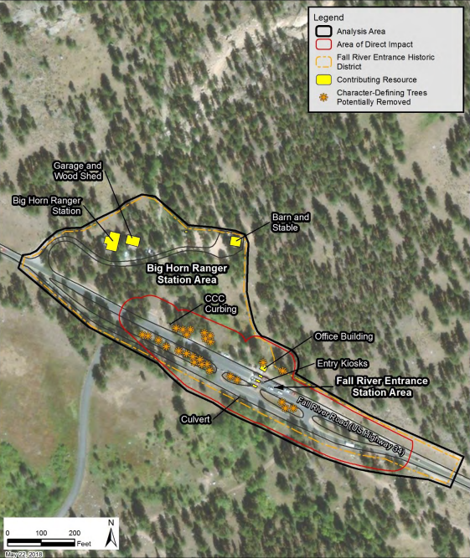
Significant Features

Slide 9
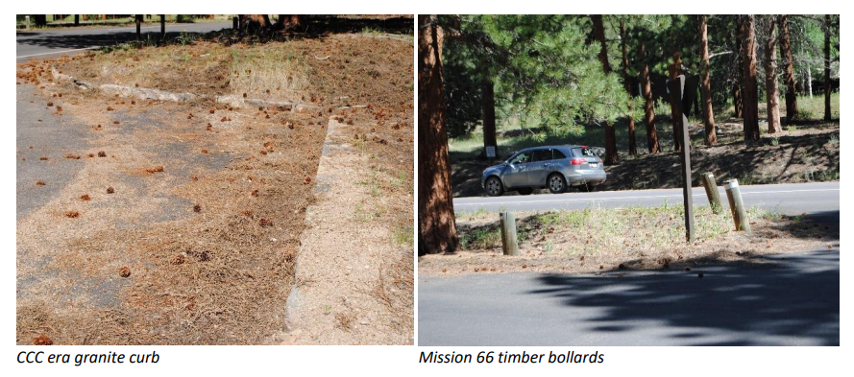
Significant Features

Slide 10
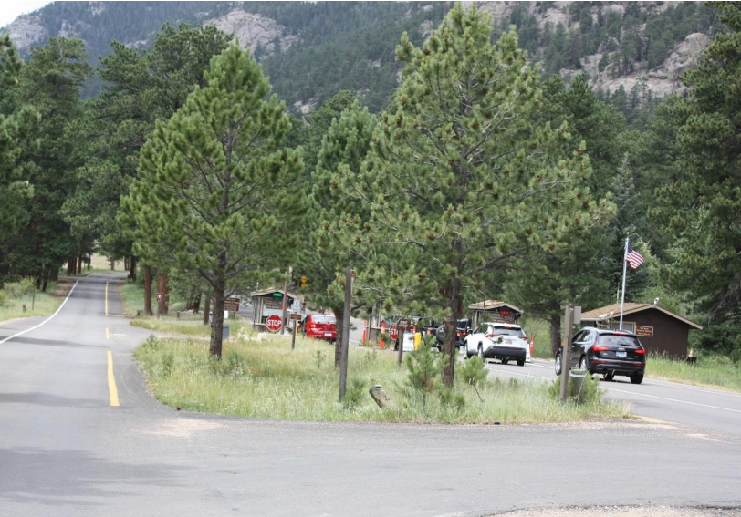
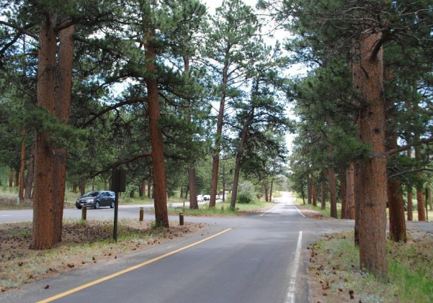
Significant Features
Character Defining Trees
Ponderosa Pines at Exit

Slide 11
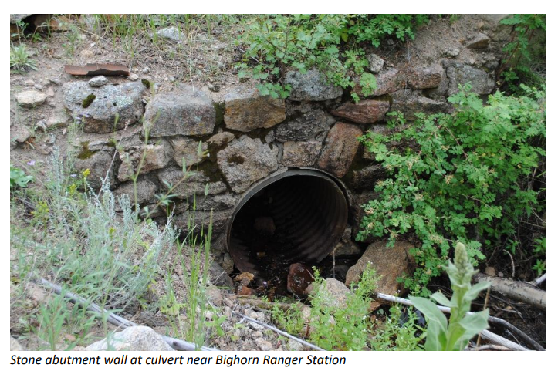
Significant Features

Slide 12
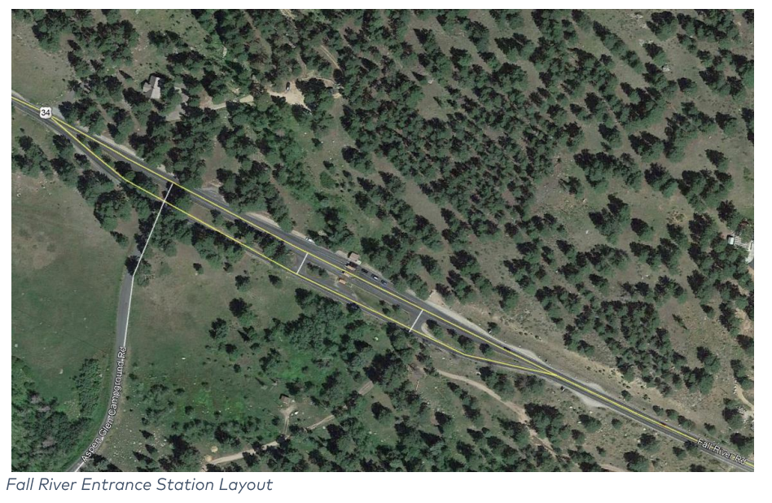
Existing Conditions
3 miles to West Horseshoe Park
Bighorn Ranger Station
Fall River Entrance
5 miles to
Estes Park

Slide 13
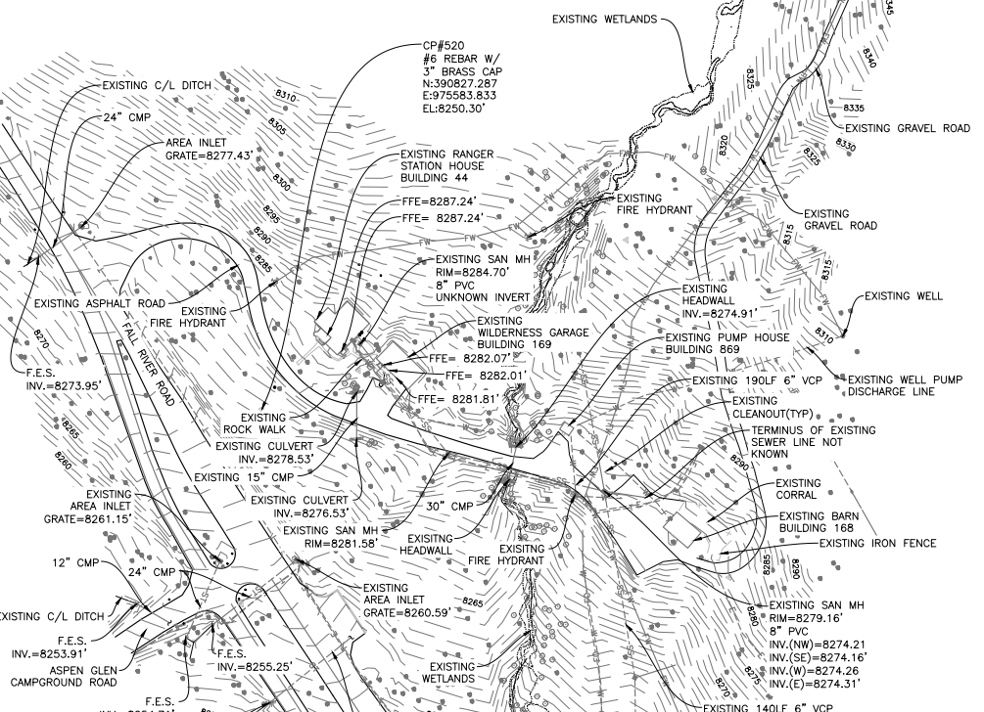
Existing Conditions

Slide 14
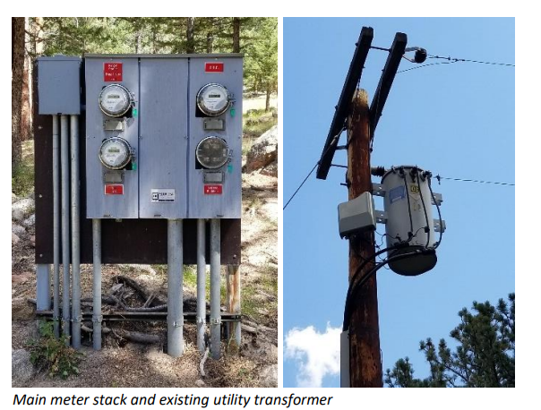
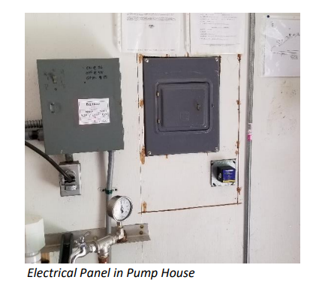
Existing Conditions

Slide 15
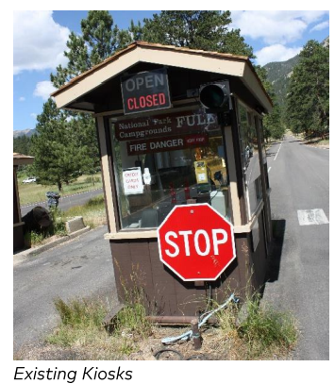
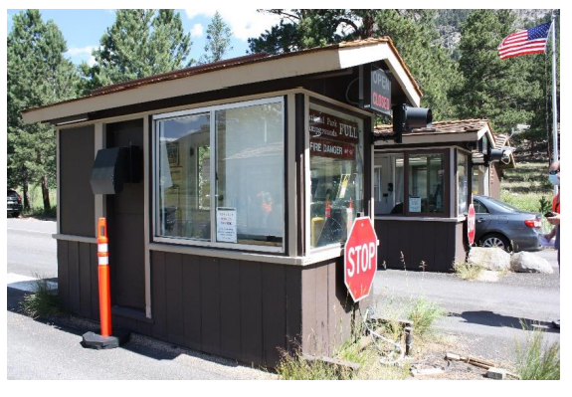
Existing Conditions

Slide 16
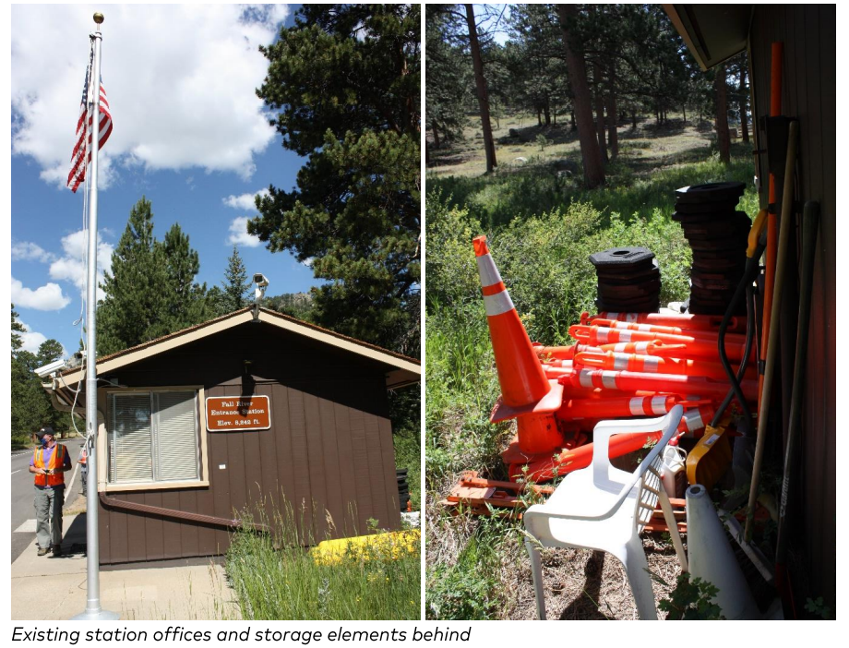
Existing Conditions

Slide 17
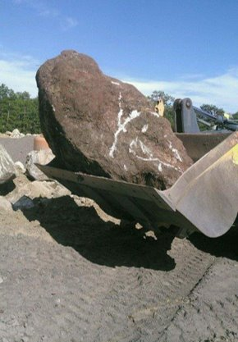
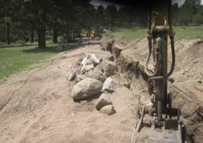
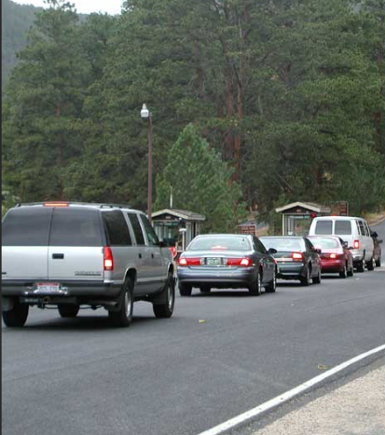
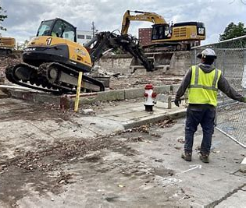
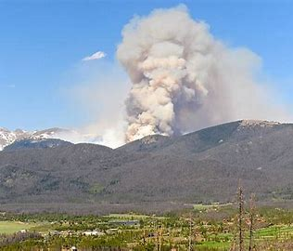
Existing Conditions
Traffic Control
Storage and Staging
Rock: Boulders + Bedrock
Weather
Stormwater Management

Slide 18
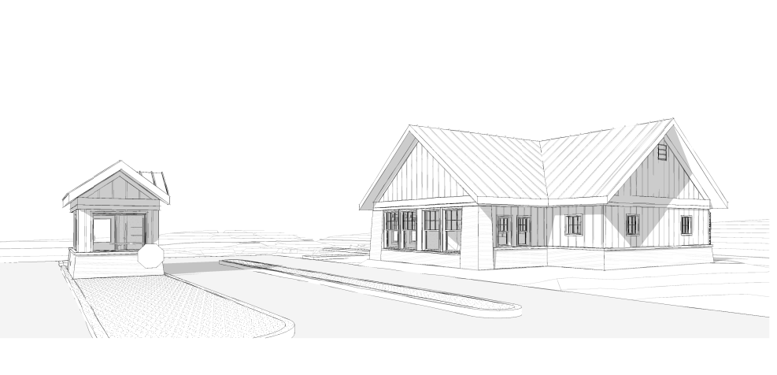
Scope of Work
Conceptual entrance view of office and kiosk, facing northwest

Slide 19
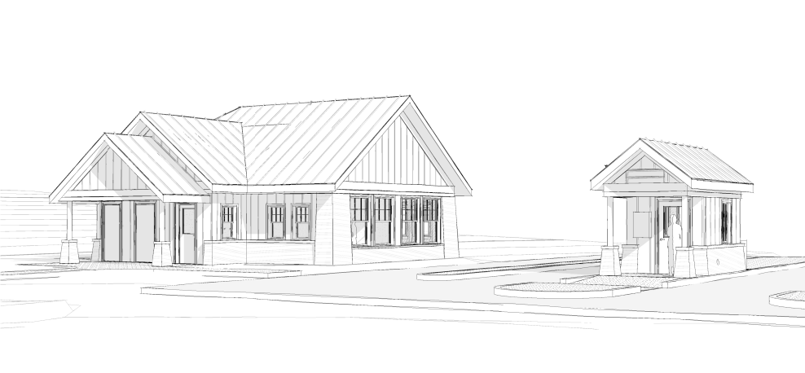
Scope of Work
Conceptual entrance view of office and kiosk, facing southeast

Slide 20
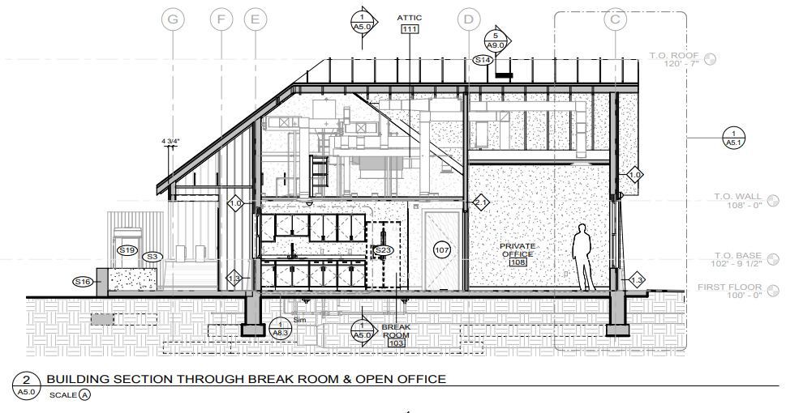
Scope of Work

Slide 21
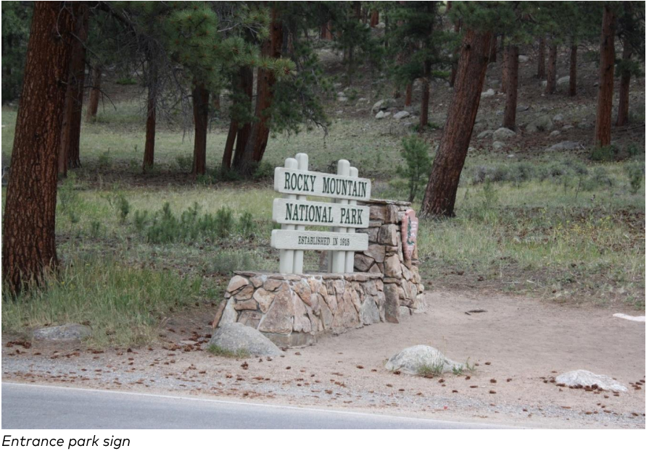
Scope of Work
Architecture
Replace Office
Replace (3) Kiosks
MEP/HVAC
Accessibility/Building Code
Utilities
Water
Wastewater
Electrical
Telecommunication
Circulation + Signage
Road Widening/Reconfiguration for Fast Pass Lane

Slide 22
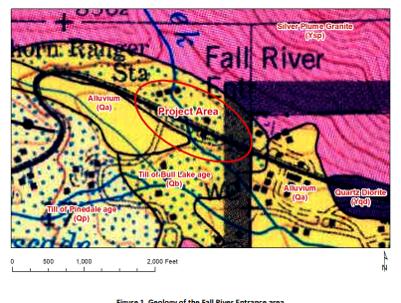
Resources
Resources for Project Information:
Technical Plans + Specifications
Appendices: Geotechnical Investigation Report, Mortar Analysis, Hazardous Materials Assessment, Areas Requiring Archeological Monitoring, Revegetation, Statement of Structural Tests and Special Inspections
Section J Documents

Slide 23
SOLICITATION NO.140P2022R0005 SUMMARY OF SOLICITATION AND AWARD INFORMATION
Refer to the Solicitation for complete information.
PRE-PROPOSAL VIRTUAL MEETING – April 7, 2022, at 9 AM MT
PRE-PROPOSAL ON SITE MEETING – April 7, 2022, at 2 PM MT
PRE-PROPOSAL QUESTIONS DUE – April 30, 2022, at 3 PM MT
OFFERS DUE – May 2, 2022, at 3 PM MT
SUBMISSION – Electronic only to: See Section L of RFP
SECTION L – 52.216-1 – Type of Contract – Firm Fixed Price
NAICS Code: 236220 - Small Business Size Standard: $39.5M
THIS IS A SMALL BUSINESS SET-ASIDE COMPETIVE PROCUREMENT
PERIOD OF PERFORMANCE: Project completion by April 1, 2023.
CONTRACT VALUE: Between $5M and $10M

Slide 24
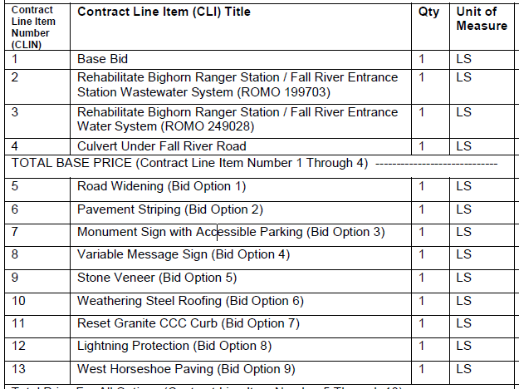
CONTRACT PRICE SCHEDULE – Definition of Contract Line Items
BID CLINS

Slide 25
Contract Line Items
The Definition of Contract Line Items are located in the Specifications, Section 01 27 00 (Pages 30-33)

Slide 26
Pre-Proposal Physical Tour

Slide 27
PRE-PROPOSAL CONFERENCE QUESTIONS
Administrative questions are the only questions permitted to be asked and answered during this conference. Please state your name and company before you ask your question. The question will be repeated, and responses provided. The CO requests all non-administrative questions be submitted in writing via email to both the CO, Tim Burger, and the CS, Bruce Beck as follows:
timothy_burger@nps.gov
bruce_beck.nps.gov
Responses to questions that may be stated during the pre-solicitation site visit do not change the Solicitation document.
Changes to the Solicitation document shall be made as an amendment to the solicitation document. Answers to questions received will be issued as an amendment to the solicitation.
PRE-PROPOSAL CONFERENCE QUESTIONS

Slide 28
QUESTIONS AFTER PRE-PROPOSAL CONFERENCE
Direct all questions the CO requests that they be submitted in writing via email to both the CO, Tim Burger, and the CS, Bruce Beck as follows:
timothy_burger@nps.gov
bruce_beck@nps.gov
Questions and answers will be issued by written amendment posted as an amendment to the solicitation. Offerors are required to fill out and sign the acknowledgment of amendments received (SF1442 Section 19) and include this when submitting your offer on the Form 1442.
The DEADLINE FOR QUESTIONS IS: April 30, 2022, 3:00 PM MT. This presentation and the recorded pre-proposal site visit meeting will be available to participants via an e-mail attachment.
For all other interested vendors not able to attend this pre-proposal site visit, an amendment will have directions on how to request this presentation and the recorded pre-proposal site visit.
PRE-PROPOSAL CONFERENCE QUESTIONS

Slide 29
Thank You For Your Interest in This Project
National Park Service
U.S. Department of the Interior

